Slide 1
INFO 5100 FINAL PROJECT | GROUP 09: THE MAKERS
GoodLife–FlexGear National Fitness & Equipment Ecosystem
Cross-boundary club memberships, serialized equipment rentals, last-mile logistics, and wellness insurance adjudication in Java Swing.
Kinder Izzo Celemin
Astrid Noizillier
Mayu Rocha Yamada
Functional Architect & GoodLife Lead
Model Designer & FlexGear Lead
Workflow Lead & Logistics/Insurance

Slide 2


01 / PROBLEM STATEMENT
Disconnected Silos in Hybrid Fitness
Members swapping home gym gear across US–Canadian suppliers face broken handoffs between clubs, warehouses, couriers, and insurers.
Unverified Safety
Delivery Bottlenecks
Stalled Claims
Blind Operations
Uncalibrated machines risk member injury.
Delayed regional heavy freight scheduling.
Slow wellness rebates freeze inventory.
Zero visibility into franchise utilization.

Slide 3
02 / ECOSYSTEM VALUE PROPOSITION
Why Every Enterprise Is Essential
COLLABORATIVE SYNERGY
1. GoodLife Club Enterprise (Kinder): Drives member demand; lacks heavy hardware maintenance.
Whole > Sum of the Parts
2. FlexGear Equipment Enterprise (Astrid): Supplies and inspects machines; needs external couriers.
Uniting clubs, hardware depots, and insurers across the US–Canada corridor unlocks end-to-end safety and affordability.
3. Logistics & Insurance Enterprise (Mayu): Executes regional freight; underwrites wellness and damage claims.

Slide 4
03 / COMPOSITE ARCHITECTURE (1 NETWORK • 3 ENTERPRISES • 6 ORGS • 8 ROLES)
Multi-Enterprise Organization & Role Matrix
Enterprise (3) | Organization (6) | Operational Roles (8 Excl. Admins) | Owner
GoodLife Fitness Club | Org 1: Member Subscriptions | Role 1: Membership Advisor | Kinder
GoodLife Fitness Club | Org 2: Club Floor Operations | Role 2: Personal Trainer • Role 3: Club Manager | Kinder
FlexGear Equipment MRO | Org 3: Catalog & Rental Desk | Role 4: Rental Coordinator • Role 5: Inventory Spec. | Astrid
FlexGear Equipment MRO | Org 4: Inspection & Repair | Role 6: Maintenance Technician | Astrid
Logistics & Insurance | Org 5: Regional Delivery Dispatch | Role 7: Delivery Coordinator | Mayu
Logistics & Insurance | Org 6: Wellness & Damage Claims | Role 8: Insurance Claims Specialist | Mayu

Slide 5
04 / SIMPLIFIED UML CLASS DIAGRAM (STRUCTURAL OVERVIEW)
Simplified Class Relationships & Cardinality
EcoSystem
1 ◆── *
Network
1 ◆── *
Enterprise
1 ◆── *
Organization
Singleton Root
US-CA Corridor
3 Subclasses
6 Subclasses
UserAccount
1 ◆── 1
Role (Abstract)
1 ◆── 1
WorkQueue
1 ◆── *
WorkRequest
Auth & Session
8 Concrete Roles
Request Routing
6 Subclasses
CustomerProfile
EquipmentUnit
DeliveryServiceArea
* ──> 1 SubscriptionPlan
* ──> 1 EquipmentModel
Postal Prefix Routing

Slide 6
05 / DETAILED UML CLASS DIAGRAM (ATTRIBUTES, METHODS & INHERITANCE)
Class Attributes, Operations & Multiplicity
Organization <>
FlexGearEquipmentEnt
WorkRequest <>
<|-- EcoSystem, Enterprise
1 ◆── * EquipmentUnit
CustomerProfile
<|-- 6 Concrete Subclasses
* ──> 1 SubscriptionPlan
- organizationID: int
- catalog: EquipmentCatalog
- requestId: String
- name: String
- serialNumber: String
- customerId: String
- sender: UserAccount [1]
- workQueue: WorkQueue [1]
- dailyRentalPrice: double
- age: int
- receiver: UserAccount [0..1]
- userAccountDir: UserAccountDir
- isAvailable: boolean
- monthlyPrice: double
- status: String
- discountPct: float
+ calcUtilization(int,int): float
+ calculateTotalOrderFee(): double
+ getSupportedRole(): List
+ calculateNetPrice(): double
+ getWorkQueue(): WorkQueue
+ updateCondition(String): void
+ deactivateCustomer(): void
+ setStatus(String): void

Slide 7
06 / POLYMORPHIC WORKQUEUE ROUTING (3 CROSS-ORG • 3 CROSS-ENTERPRISE)
End-to-End Work Request Lifecycle
WR1 • CROSS-ORG (ENT 1)
WR2 • CROSS-ENT (1 TO 2)
WR3 • CROSS-ORG (ENT 2)
FitnessAssessment
EquipmentRentalOrder
EquipmentInspection
Advisor to Personal Trainer.
Club Manager to FlexGear Desk.
Rental Desk to Maintenance Tech.
WR4 • CROSS-ENT (2 TO 3)
WR5 • CROSS-ORG (ENT 3)
WR6 • CROSS-ENT (1 TO 3)
DeliveryAppointment
EquipmentDamageClaim
WellnessSubsidyClaim
Inventory Spec to Courier Dispatch.
Courier to Claims Specialist.
Advisor to Claims Specialist.

Slide 8



07 / BRIEF ADVANCED FEATURE INTRODUCTION
Advanced Platform Engineering Features
Java Faker Auto-Seeding & DB4O Object Persistence
Pre-populates 100+ members and 50+ requests; serializes state to DataBank.db4o.
Automated JavaMail Alerts & Postal Service-Area Routing
Triggers email dispatches on claim approvals; maps postal prefixes to couriers.
Non-Destructive Soft-Deletes & Regex Input Guardrails
Preserves referential audit history via status flags; blocks null or invalid primitives.

Slide 9
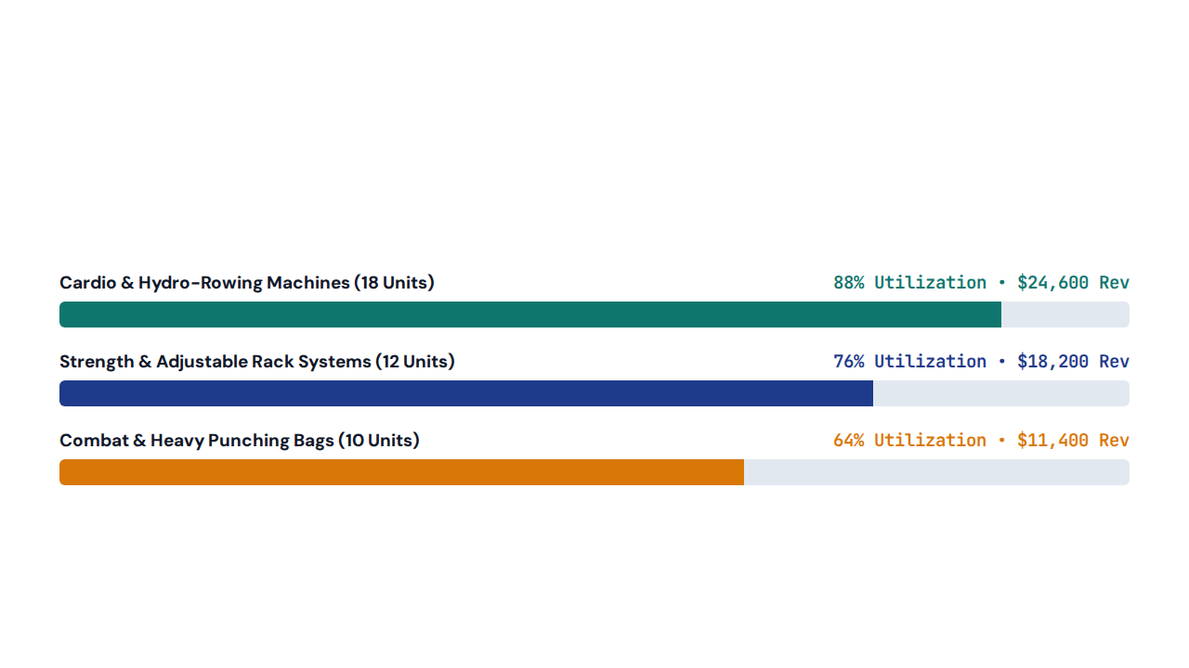
08 / NETWORK-LEVEL REPORTING MODULE
Equipment Utilization & Rental Volume by Category

Slide 10
NEXT: 20-MINUTE LIVE JAVA SWING DEMONSTRATION
Live Ecosystem Walkthrough & Q&A
Demonstrating Admin CRUD, Faker Seeding, GoodLife Club Operations, FlexGear MRO Inspections, and Logistics/Insurance Settlement.

